Slide 1


Safety Glove
Proposed By: Team Vibhav

Slide 2

About the project
The idea is to design a safety glove consisting of a Hall Effect Sensor, Arduino Mega and a radio transmitter, which is to be worn by the workers in factories who are in close proximity to heavy machinery which can cause potential injuries.
As soon as the gloves are at a dangerously close distance, the machinery will automatically shut down, thus avoiding any damage or injuries.

Slide 3
Problem that project solves
In industries usually the hands accidents happen, when the hands come in contact with the moving parts, which results in heavy injuries, amputations and deaths.

Slide 4
Solution to the problem
The hand accidents in industries can be minimized by designing special type of safety glove which can turn off the machine when a hand comes in contact with the moving part.

Slide 5
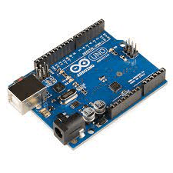
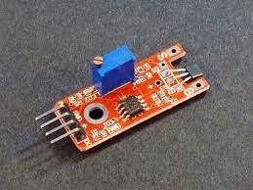
Techstack
Arduino
Proximity Sensor
Arduino Uno/Mega/Nano
2-Channel Relay
Magnetic Hall Effect Sensor
Radio Frequency TX and RX(433HZ)

Slide 6
Specifications
Hall Effect Sensor
It has three male headers which are clearly labeled as 5v, OUT, and GND.
This is the Sensor which detects the presence of the magnet.
Distance at which it detects the magnetic field is 5-8mm.
Radio Frequency TX and RX
433 MHz Radio Frequency Transmitter is required
It has 4 headers as VCC,DATA GROUND ANTENNA

Slide 7
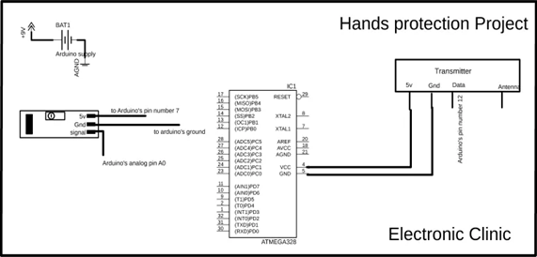
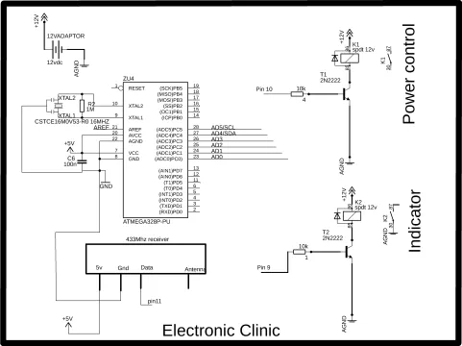
Circuit Diagram

Slide 8
Execution
The project consists of two parts – the transmitter end (glove) and the receiver end (machinery).
• At the transmitter end, our glove will have a hall effect sensor, which will detect if the hand is too close to the machinery, connected to an Arduino Uno.
• Also, there will the Radio Transmitter connected to the Arduino Uno, to send a signal to the receiving part on the machine.
• On the receiver end will be a radio receiver, connected to Arduino Mega which in turn is connected to a two channel relay, which can, shut down the machine as soon as it receives the signal from transmitter end .

Slide 9
Novelty Of the Solution
Its newly constructed model.
It automatically switches off the heavy machines which can lead to hand injuries.
It was not used earlier because its little bit difficult to make it wearable.

Slide 10
Social Aspect
It will help to increase security for workers who work in hazardous conditions and work with machineries.

Slide 11
Business Aspect
S.No. | Item | Qty | Cost/ Unit | TOTAL COST
1 | Magnetic Hall Effect Sensor | 1 | 100 | 100
2 | Arduino Uno | 1 | 400 | 400
3 | Arduino Mega | 1 | 700 | 700
4 | Two Channel Relay | 1 | 200 | 200
5 | Radio TX and RX | 1 | 200 | 200
 |  |  | TOTAL COST | 1600
The total cost of this Safety Glove is Rs 1600 .
The workers will buy this safety glove as the cost of this glove is worth for the injuries cause due to heavy machines.

Slide 12
Thank You

